Slide 1
Fake Troves: @HackingRedstone
2019-04-03
CS795/895
Puneeth Bikkasandra
Old Dominion University

Slide 2
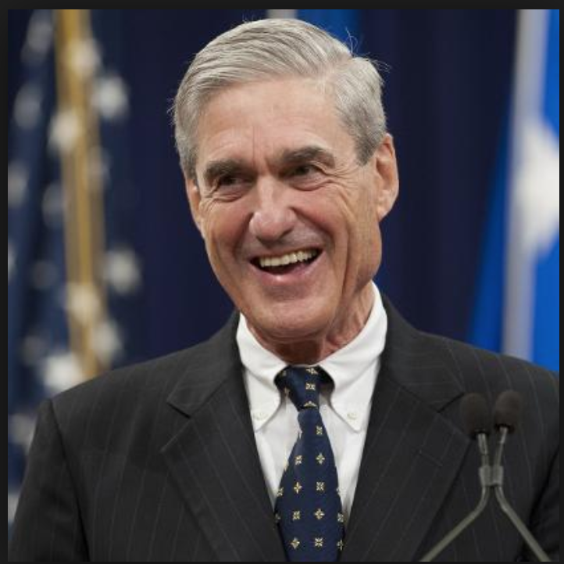
Robert Swan Mueller
American Lawyer
Former Marine
Former Director of FBI (2001 - 2013).
Special Counsel (DOJ) -
Russian Interference - 2016 United States Elections
(May, 2017 - Mar, 2019).
https://en.wikipedia.org/wiki/Robert_Mueller

Slide 3
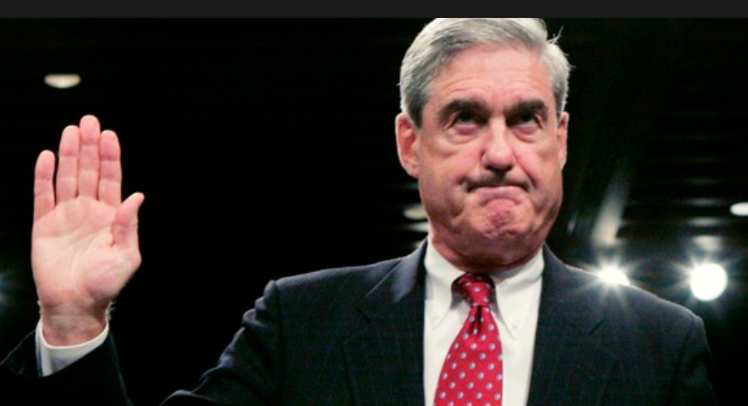
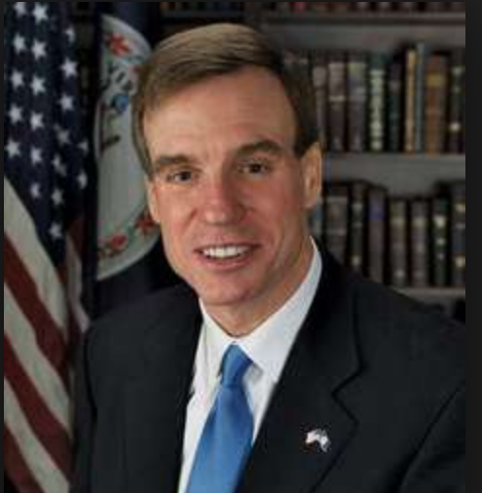
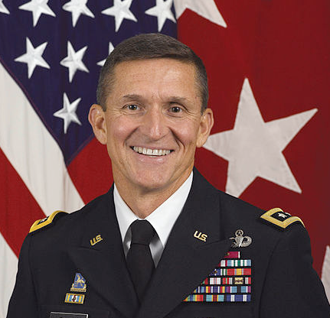
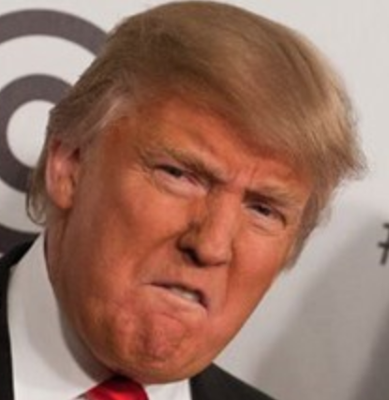
July, 2017:
Senator Mark Warner,
warns Constitutional Crisis, if fired!
December, 2017:
Michael.T.Flynn (NSA),
Testifies Trump teams direction to connect with Russians
May, 2017:
Appointed as Counsel of DOJ
February, 2018:
Mueller indicted 13 Russian individuals and 3 Russian companies for attempting to trick Americans in to consuming Russian propaganda
March, 2019:
Mueller concludes probe stating -
“The Special Counsel's investigation did not find that the Trump campaign or anyone associated with it conspired or coordinated with Russian in its efforts to influence the 2016 U.S. presidential election"
October, 2017:
Mueller, files charges against Trump campaign chairman for ‘Conspiracy against United States.’
May, 2018:
Trump tweets -
“The World's most expensive Witch Hunt has found nothing on Russia & me so now they are looking at the rest of the World!”
June, 2017:
Trump orders
to fire Mueller
https://en.wikipedia.org/wiki/Robert_Mueller

Slide 4
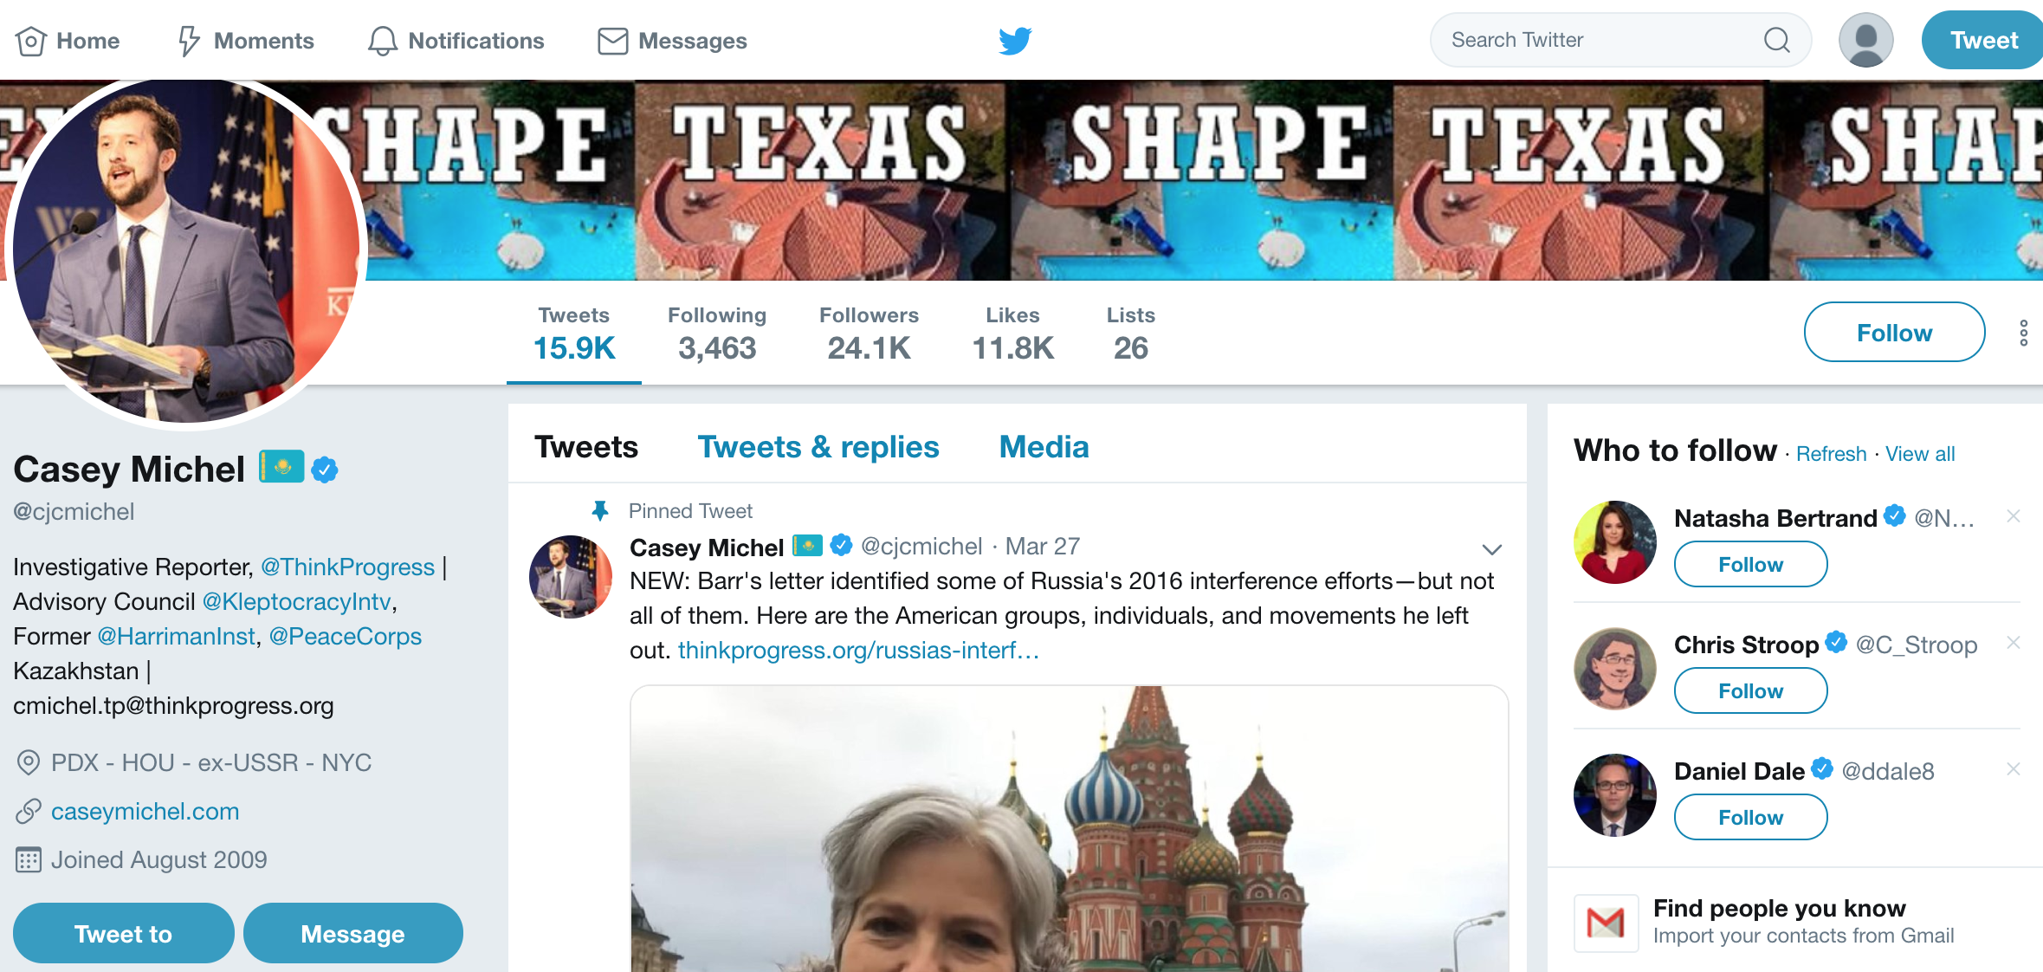
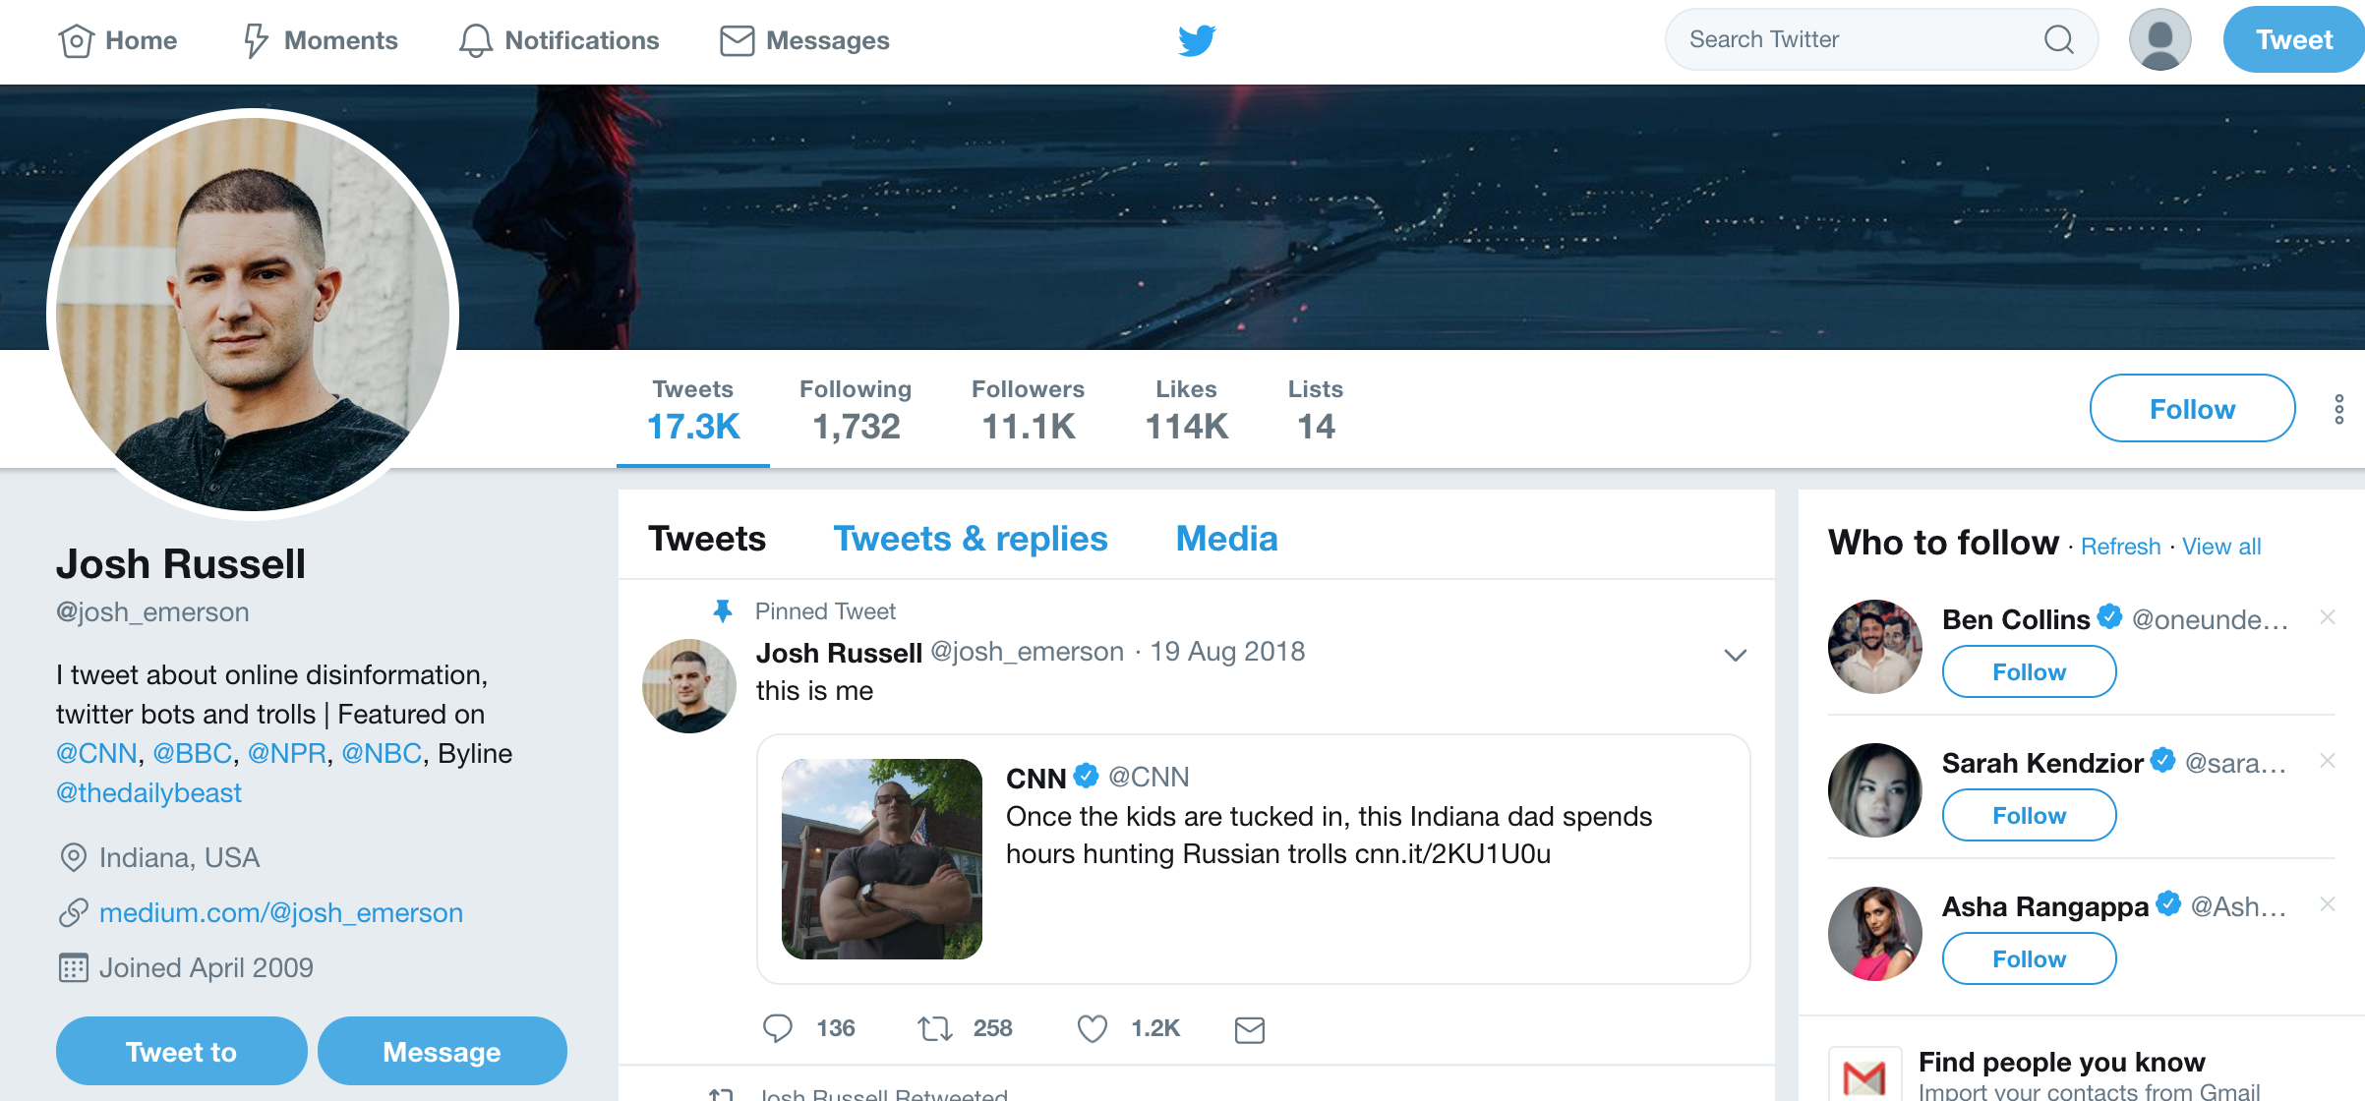
@josh_emerson and @cjcmichel: DM recipients
https://twitter.com/josh_emerson?lang=en
https://twitter.com/cjcmichel

Slide 5
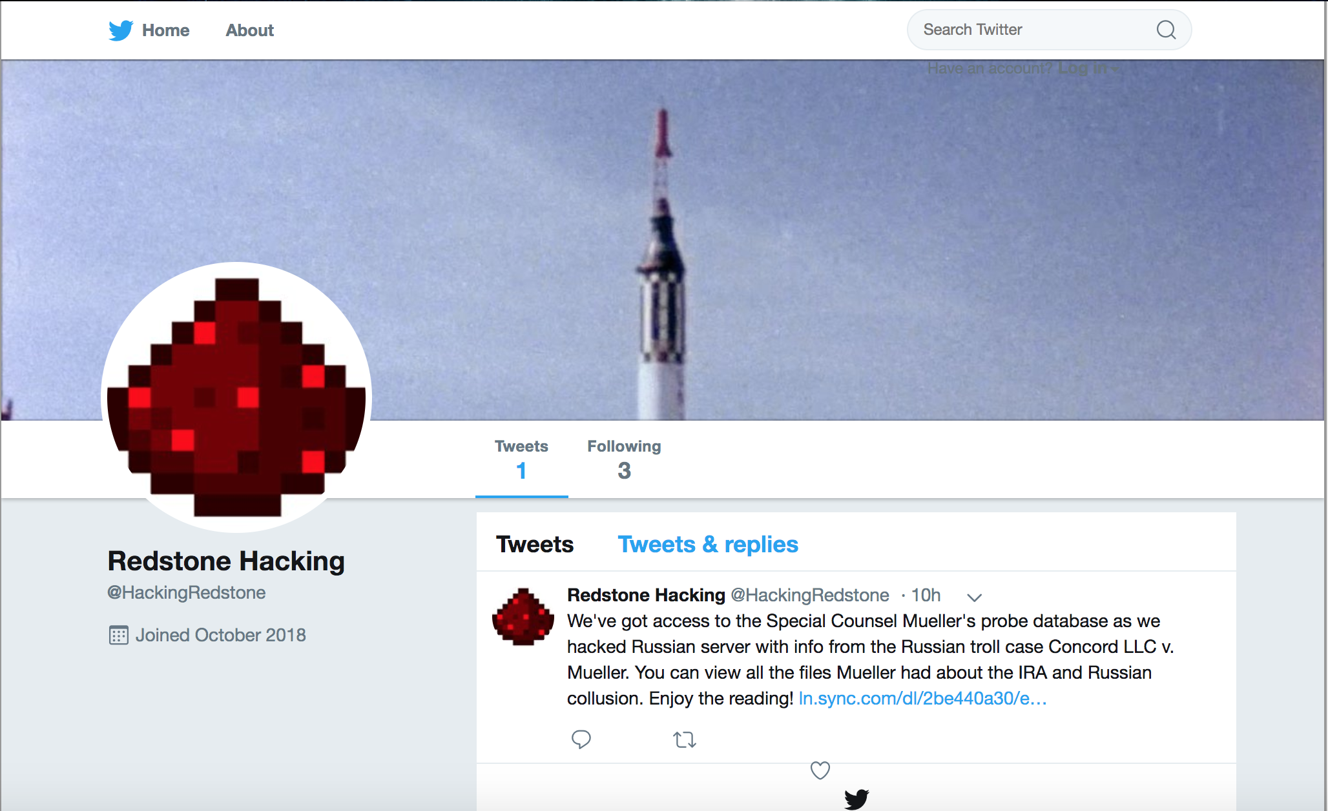
@HackingRedStone: November 2018
https://archive.is/3vOwn

Slide 6
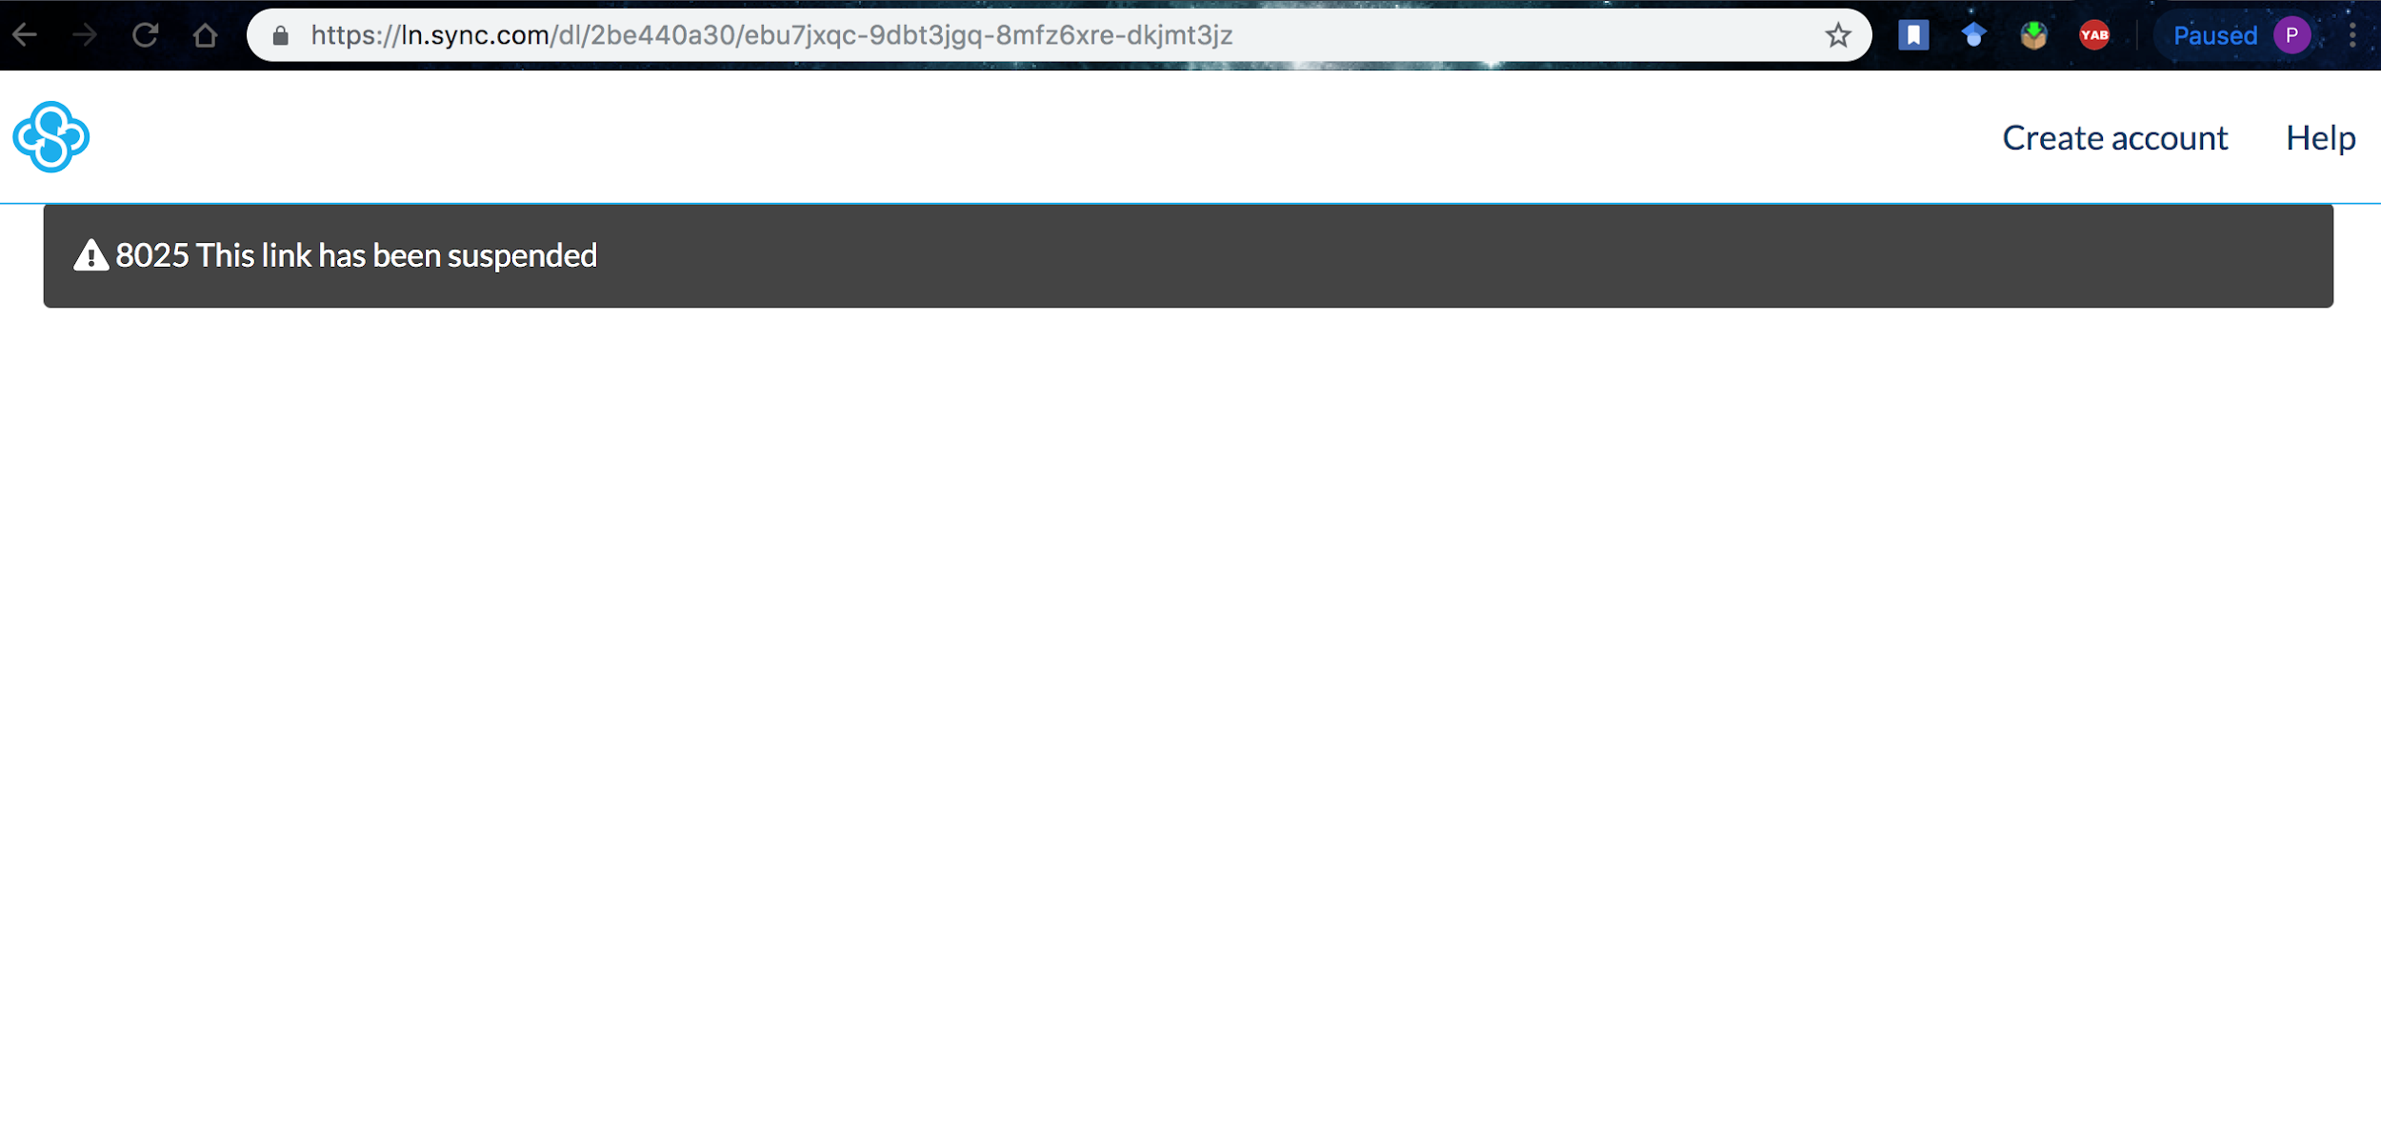
URL on the tweet does not have content!
https://ln.sync.com/dl/2be440a30/ebu7jxqc-9dbt3jgq-8mfz6xre-dkjmt3jz

Slide 7
Captured on archives??
curl --silent http://memgator.cs.odu.edu/timemap/link/https://ln.sync.com/dl/2be440a30/ebu7jxqc-9dbt3jgq-8mfz6xre-dkjmt3jz | grep datetime | awk '{print $1}'
<http://archive.md/20190130231855/https://ln.sync.com/dl/2be440a30/ebu7jxqc-9dbt3jgq-8mfz6xre-dkjmt3jz>;
<http://archive.md/20190202014634/https://ln.sync.com/dl/2be440a30/ebu7jxqc-9dbt3jgq-8mfz6xre-dkjmt3jz>;

Slide 8
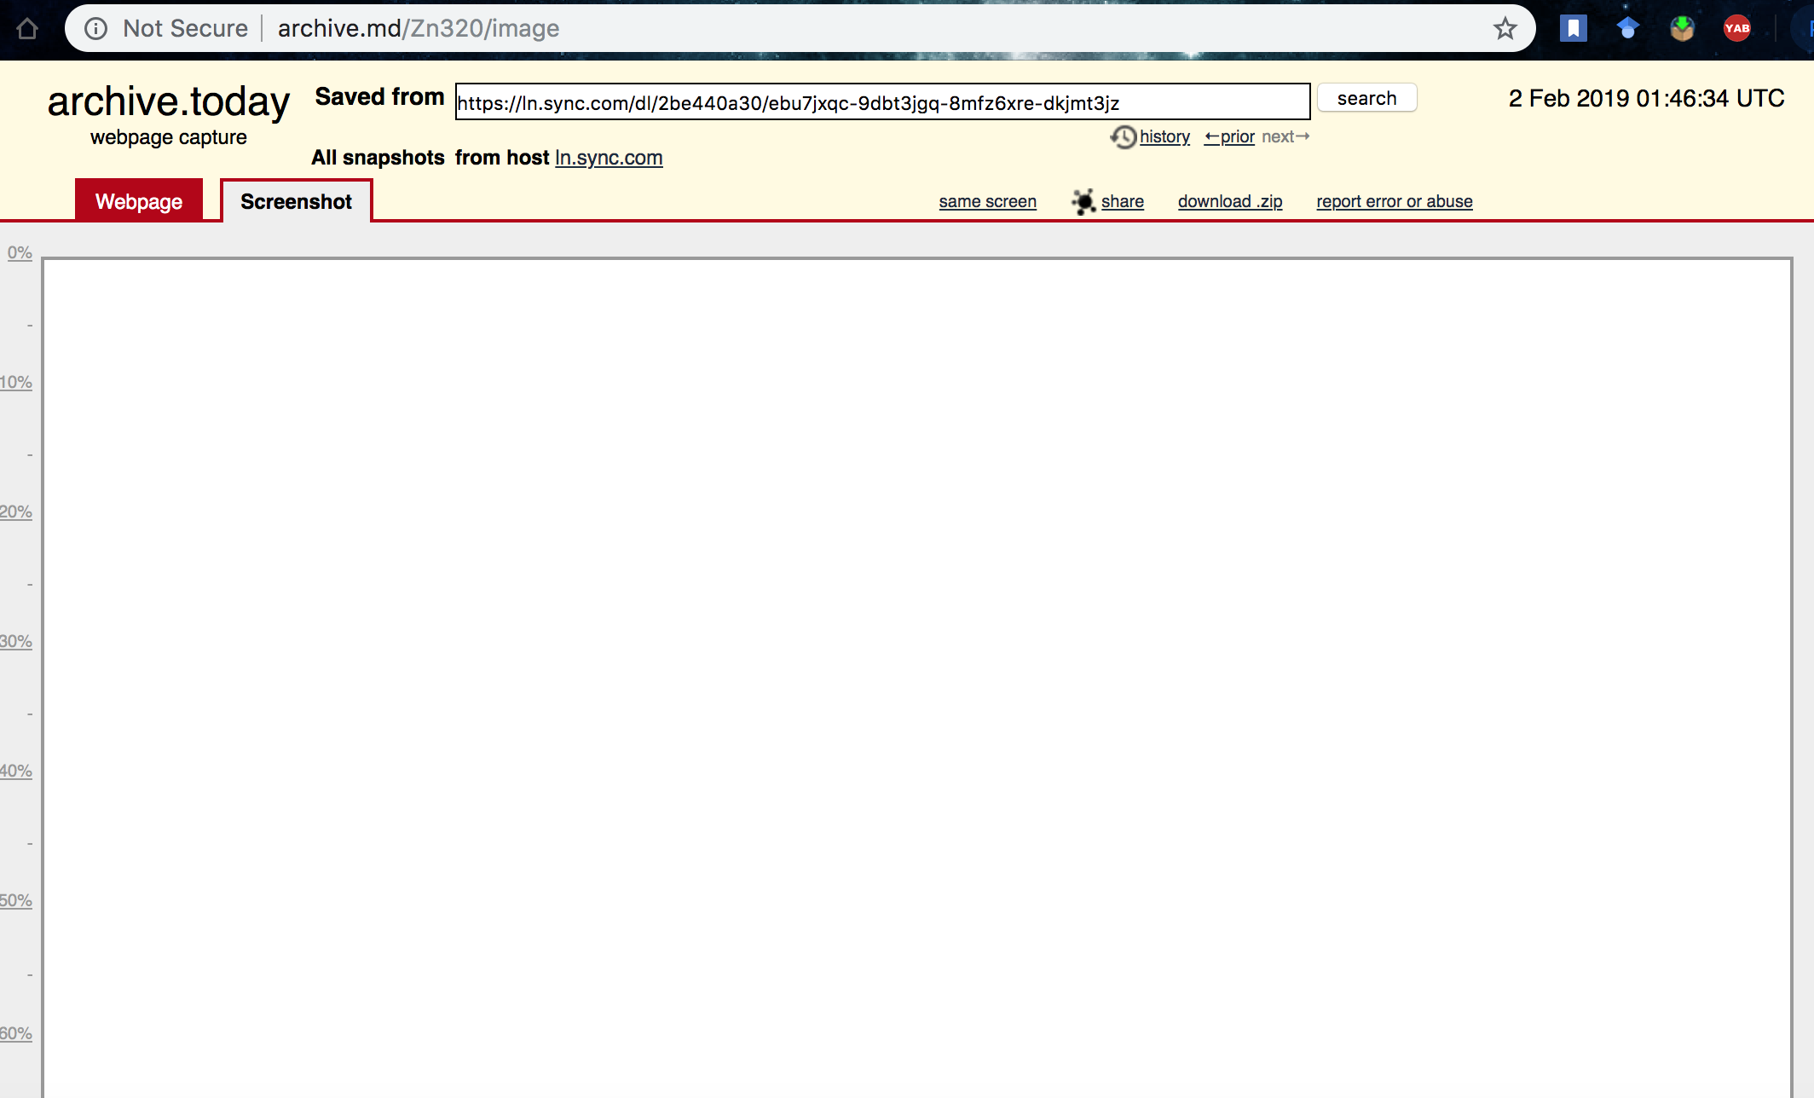
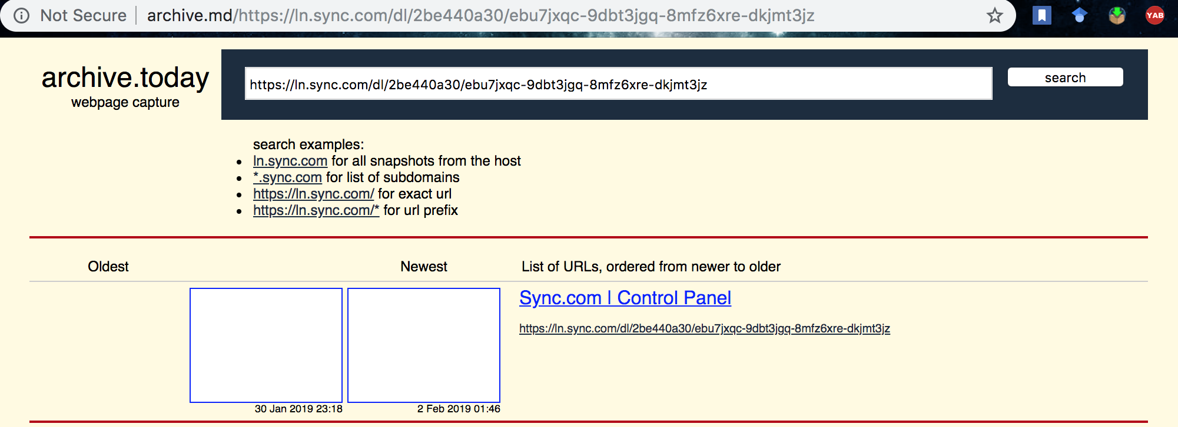
Archived pages do not render!
http://archive.md/https://ln.sync.com/dl/2be440a30/ebu7jxqc-9dbt3jgq-8mfz6xre-dkjmt3jz
http://archive.md/Zn320/image

Slide 9
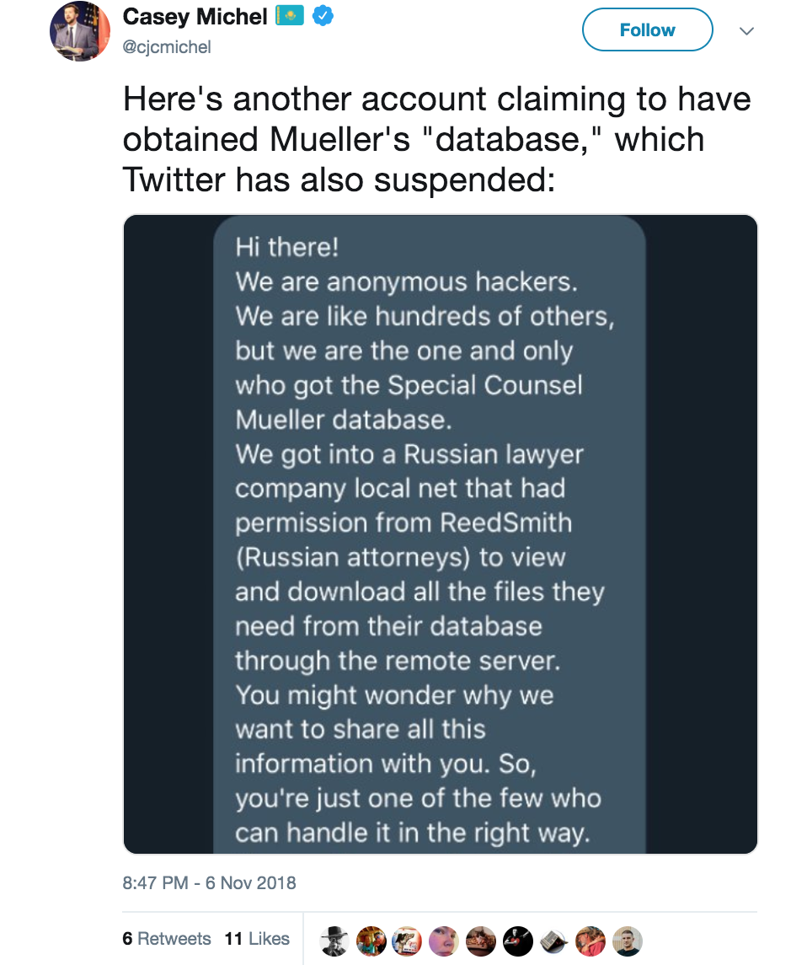
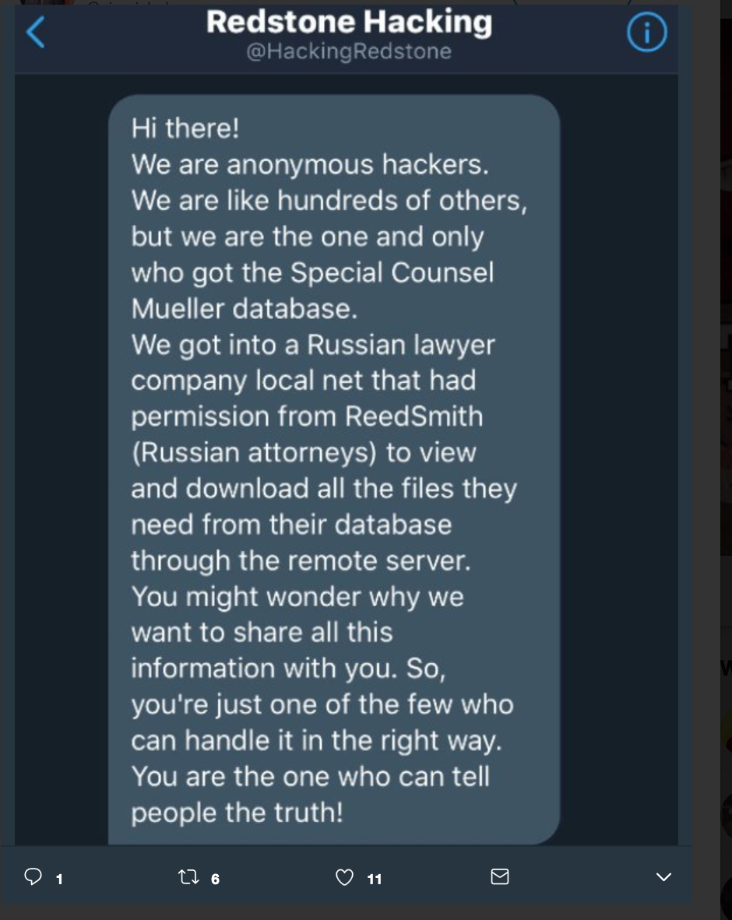
@HackingRedstone tweet
https://twitter.com/cjcmichel/status/1059827233458741253

Slide 10
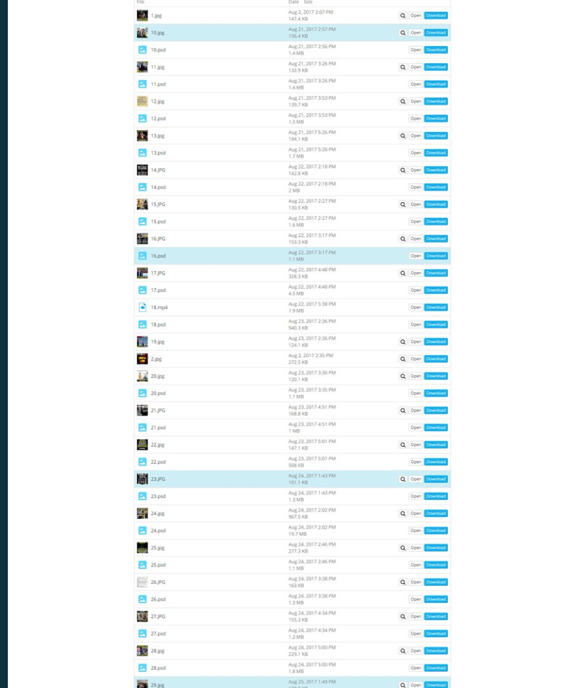
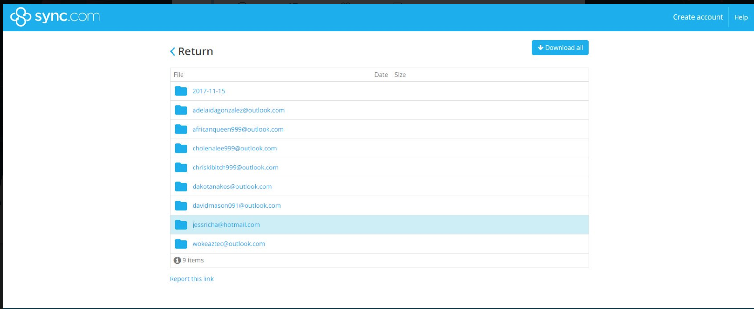
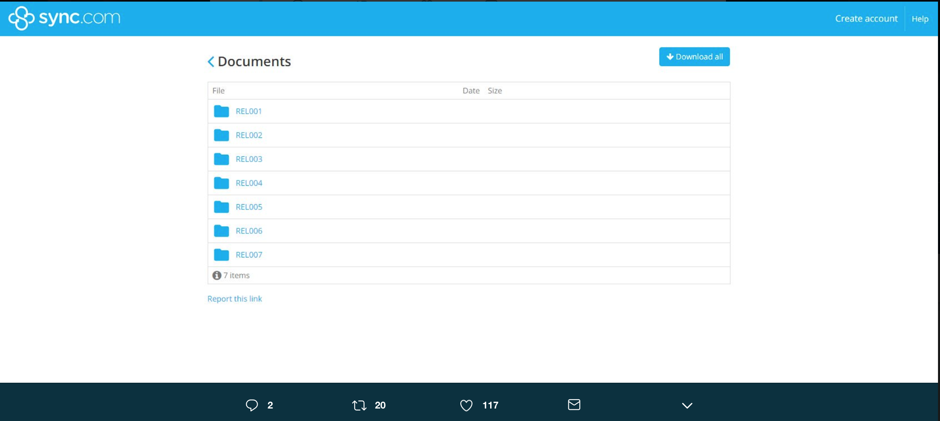
What did they release?
https://twitter.com/josh_emerson/status/1060160355022921728

Slide 11
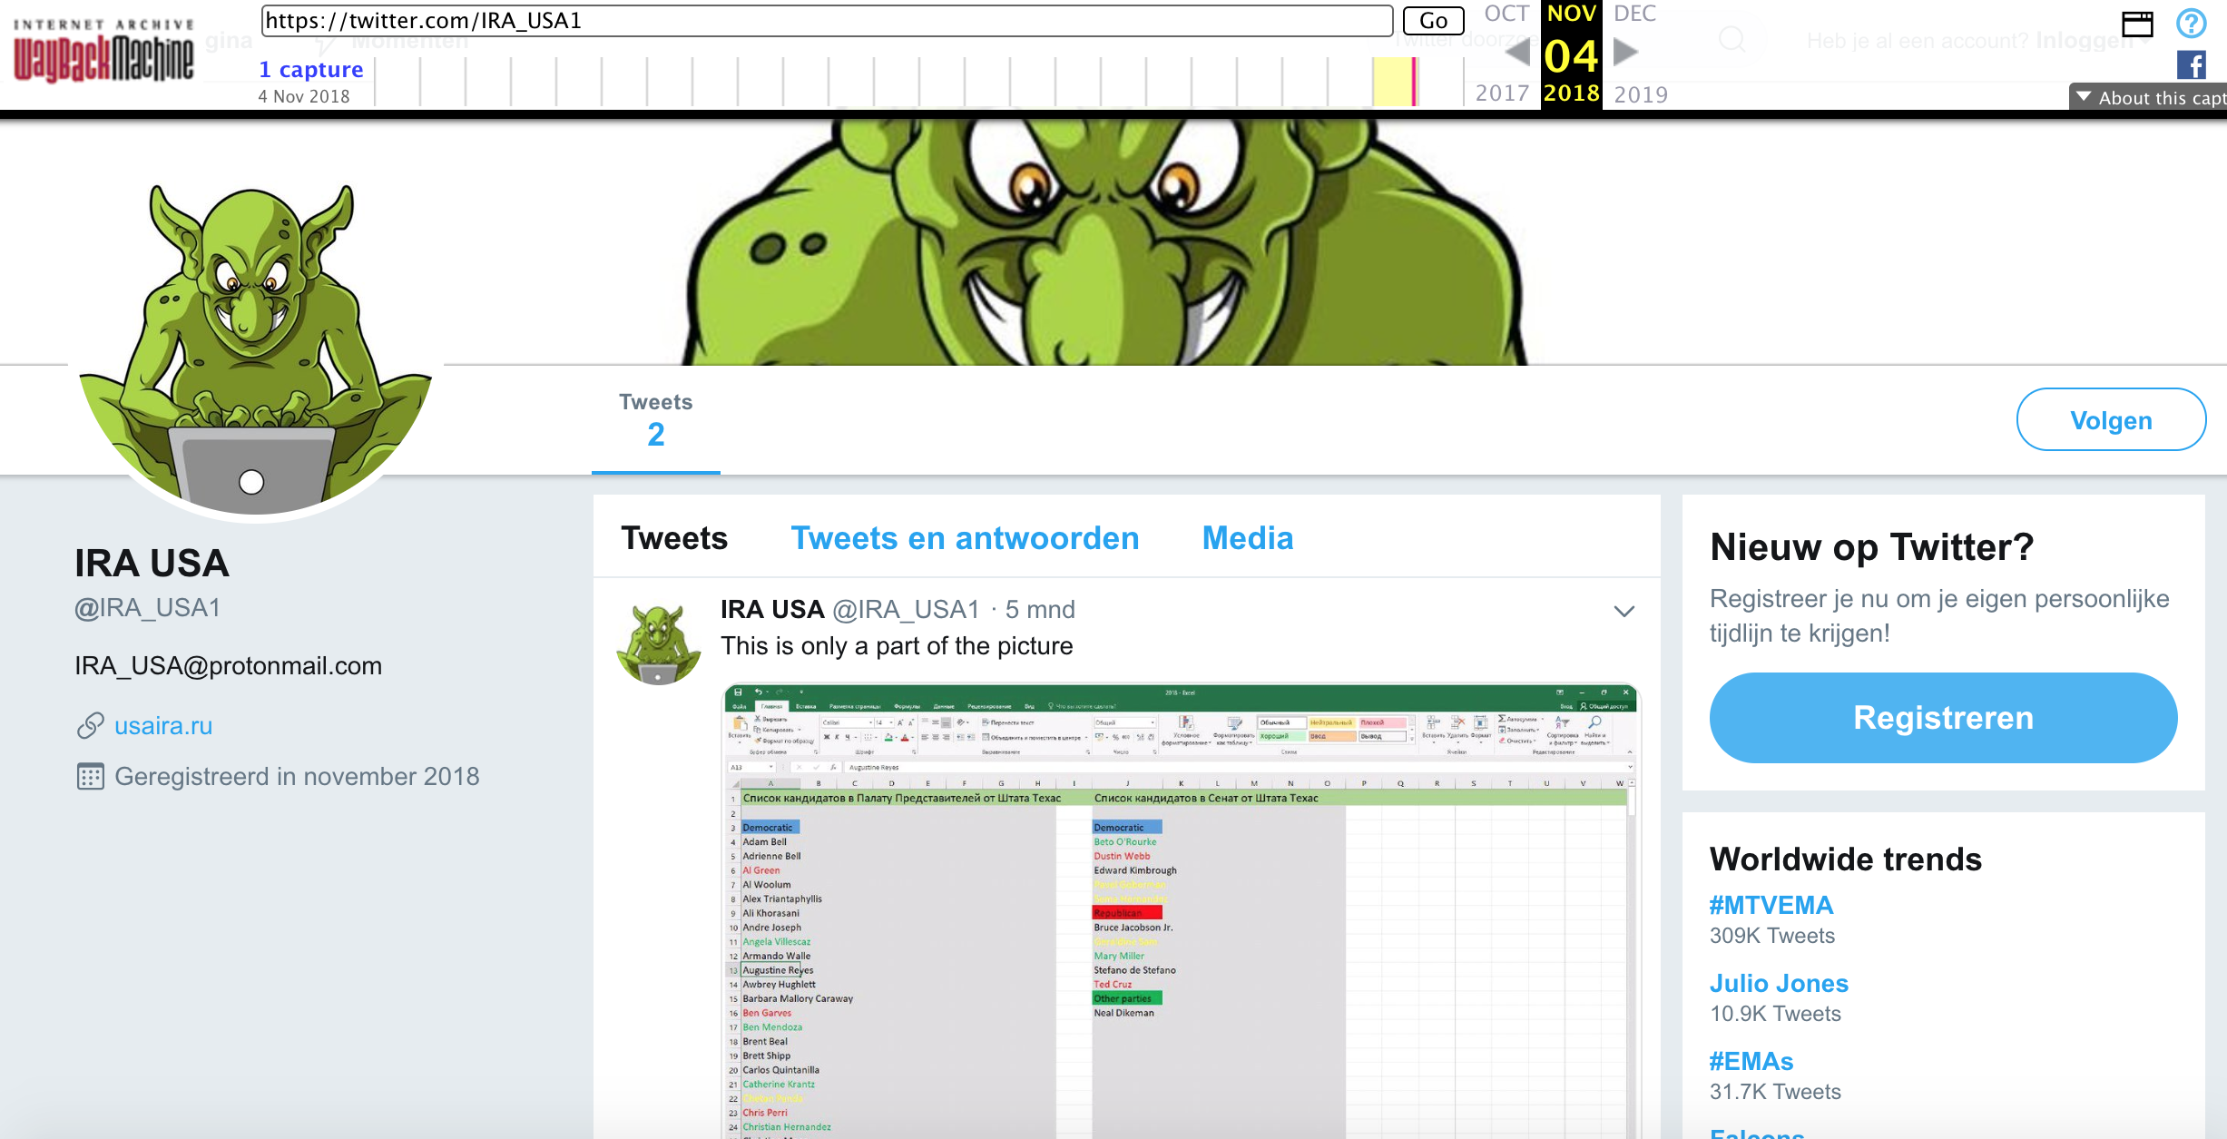
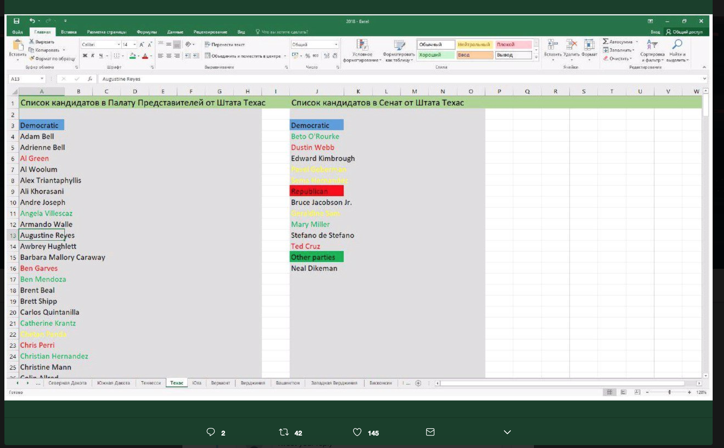
@IRA_USA1 tweet:
https://web.archive.org/web/20181104205316/https:/twitter.com/IRA_USA1
https://twitter.com/josh_emerson/status/1060160355022921728

Slide 12
Website doesn’t show any content!
curl -i USAIRA.ru
HTTP/1.1 200 OK
Server: nginx
Date: Wed, 03 Apr 2019 13:18:43 GMT
Content-Type: text/html; charset=utf-8
Transfer-Encoding: chunked
Connection: close
Expires: Wed, 03 Apr 2019 13:28:43 GMT
Cache-Control: max-age=600
X-Frame-Options: DENY

Slide 13
Website is archived!
curl --silent http://memgator.cs.odu.edu/timemap/link/https://USAIRA.ru | grep datetime
<http://web.archive.org/web/20170101212110/http://usaira.ru:80/>; rel="first memento"; datetime="Sun, 01 Jan 2017 21:21:10 GMT",
<http://web.archive.org/web/20170505083524/http://usaira.ru:80/>; rel="memento"; datetime="Fri, 05 May 2017 08:35:24 GMT",
<http://web.archive.org/web/20181104190528/https://usaira.ru/>; rel="memento"; datetime="Sun, 04 Nov 2018 19:05:28 GMT"
.
.
.

Slide 14
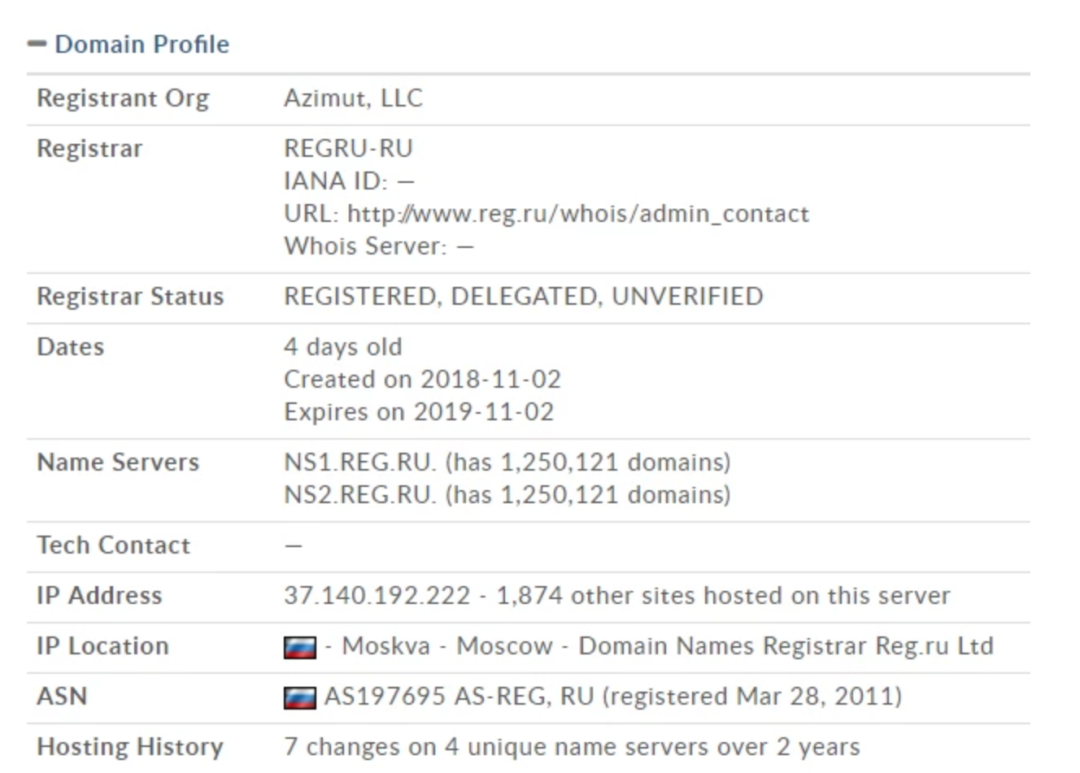
Website domain details:
https://thinkprogress.org/usaira-russian-trolling-ahead-of-the-midterm-elections-is-a-mixture-of-the-weird-and-the-pathetic-c64b0d120ae5/

Slide 15
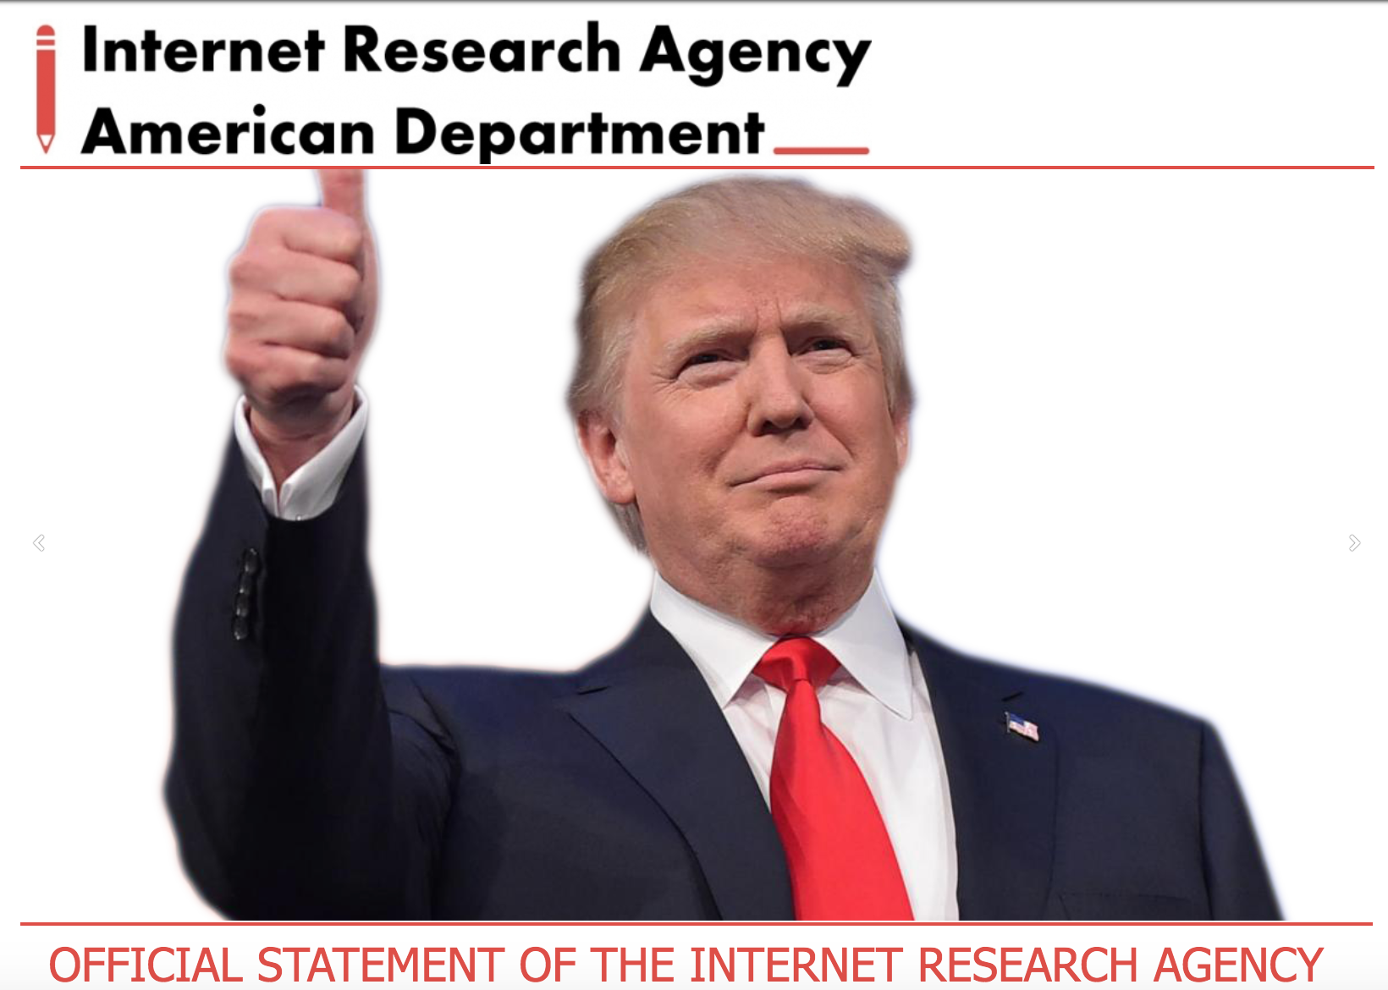
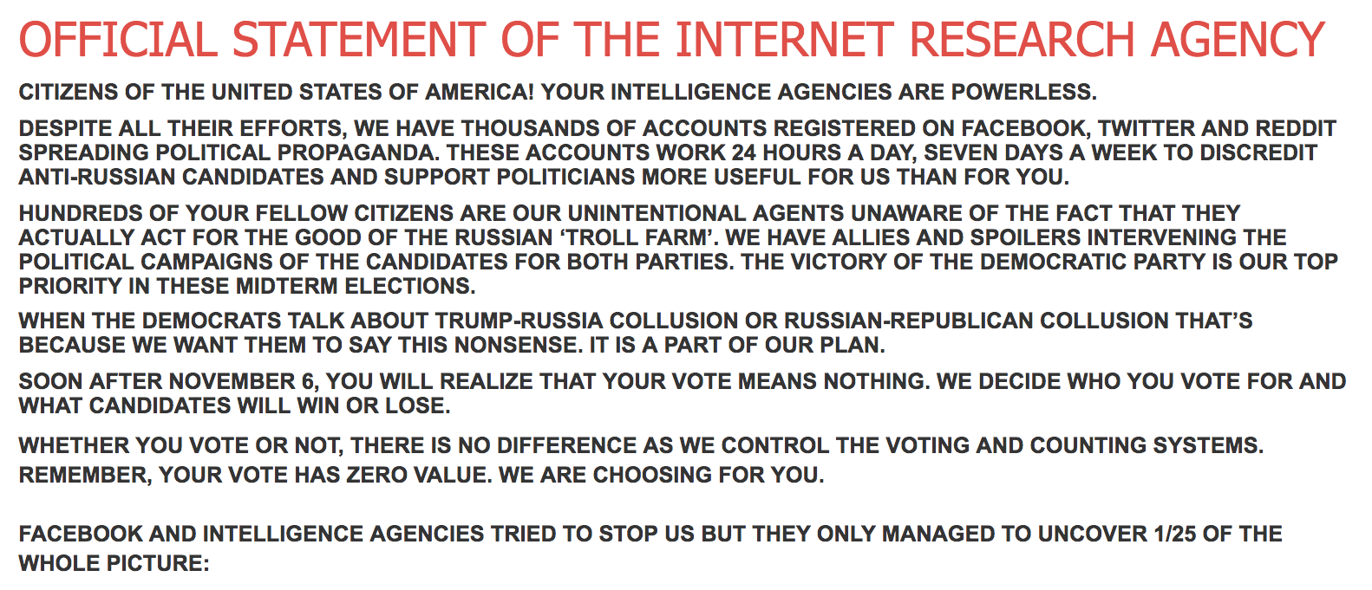
@IRA_USA1 account linked specifically to a website: USAIRA.ru
https://web.archive.org/web/20181108210320/https://usaira.ru/

Slide 16
Usaira.ru Operations:
Azimut LLC is one of the indicted by Mueller,used to move funds” from Concord Management and Consulting.
Involved in Russia’s social media interference in US Elections, claims to be home of IRA’s official website.
Twitter has not confirmed that @USA_IRA1 as Russian state-sponsored campaign, but has suspended the account.
https://www.theatlantic.com/politics/archive/2018/02/rosenstein-mueller-indictment-russia/553601/

Slide 17
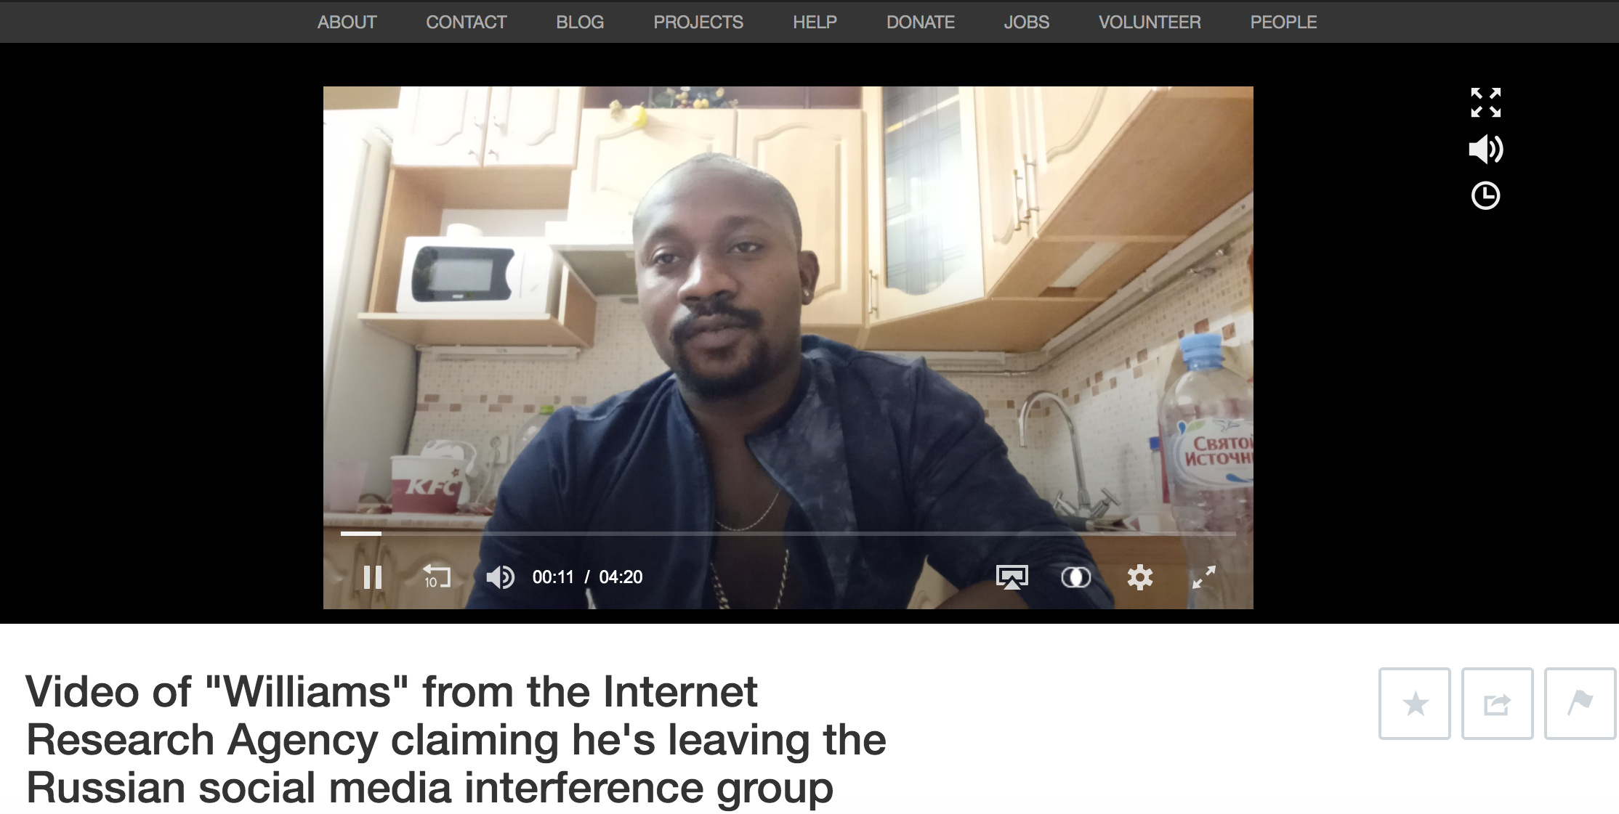
A man confesses - involved in Russian Interference in US Elections
https://archive.org/details/Httpswww.youtube.comwatchvrL4ROq_6RC4

Slide 18
Excerpts from video:
Man (calling himself as Williams), claims to be with IRA and wants to come clean and reveal their agenda.
Colleagues received threats from American Military, support Republicans for House of Representatives, and Democrats for Senate”
Managed to escape with some documents in the office titled “Technical Tasks”
“If i disapear this video will explain who and why did it.”
Not allowing him to quit saying “We are one organization [you’re] not going anywhere.”
https://thinkprogress.org/russian-social-media-troll-youtube-twitter-4600e8d2a6b7/
https://archive.org/details/Httpswww.youtube.comwatchvrL4ROq_6RC4

Slide 19
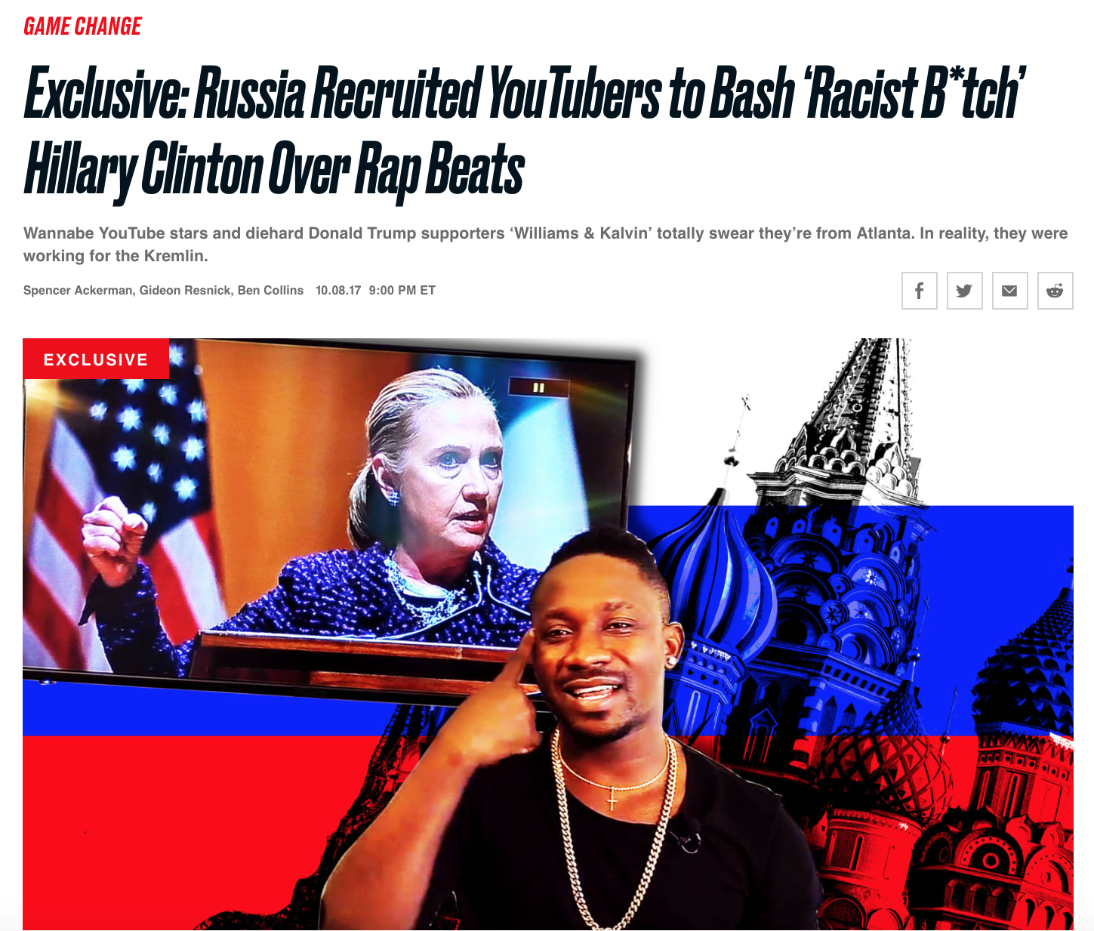
“Williams and Kalvin” team are fake - The Daily Beast
https://www.thedailybeast.com/russia-recruited-youtubers-to-bash-racist-btch-hillary-clinton-over-rap-beats?ref=scroll

Slide 20
Excerpts from Mueller’s Indictment:
Communicated with individuals associated with the Trump Campaign.
Posted derogatory comments on republican candidates,supporting Bernie Sanders and Trump.
Bought space on computer servers in the U.S. to set up a virtual private network and established hundreds of accounts on social media.
https://www.justice.gov/file/1035477/download

Slide 21
Continued...
Organized political rallies and to spread fake ads that criticized Clinton.
‘Florida Goes Trump’ rally through FB group “Being Patriotic” and @March_for_Trump.
Opened financial accounts under fake names at U.S. banks to supports its efforts.
https://www.justice.gov/file/1035477/download
https://www.nbcnews.com/politics/politics-news/special-counsel-mueller-charges-13-russians-interfering-2016-election-n848686

Slide 22
Take Away
Twitter’s rapid response and the information laid out in Mueller indictments, to put a break for Russia’s efforts in US Elections.
Irrelevant files obtained were used to discredit the investigation.
The Special Counsel stated that “while this report does not conclude that the President committed a crime, it also does not exonerate him."

